Slide 1
Accessing The File System From Node.js- Opening
P.VIVASWANTH
22H51A05B8
CSE-D

Slide 2
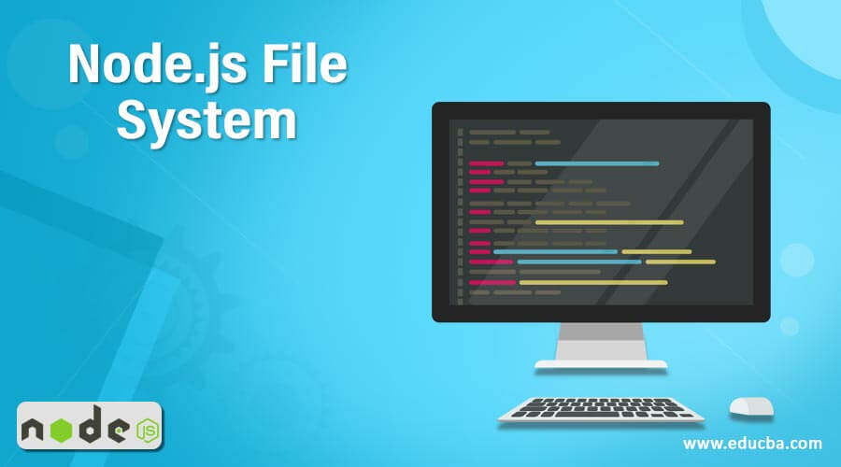
Introduction to Node.js File System Access
Node.js provides a built-in module called `fs` for file system operations.
Accessing the file system allows developers to read, write, and manipulate files easily.
Understanding how to open files is a fundamental skill for working with Node.js applications.
Notes:
Image source: https://www.educba.com/node-dot-js-file-system/

Slide 3
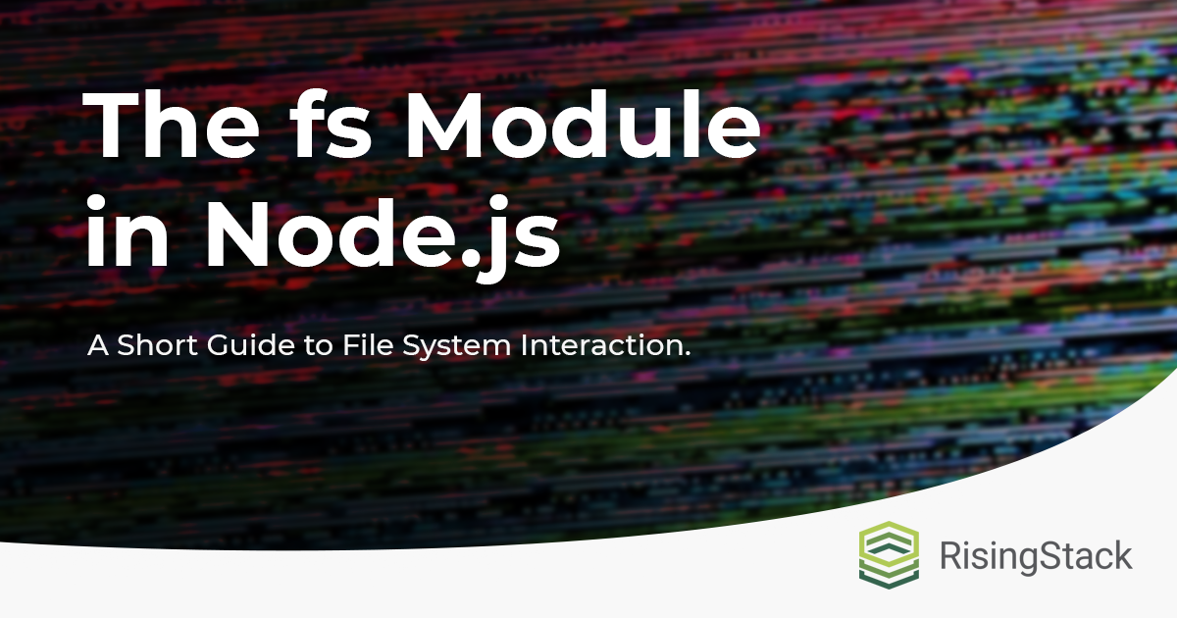
The `fs` Module Overview
The `fs` module is part of Node.js's core modules and does not require installation.
It provides both synchronous and asynchronous methods for file operations.
Familiarity with this module enables efficient file handling in your applications.
Notes:
Image source: https://blog.risingstack.com/fs-module-in-node-js/

Slide 4
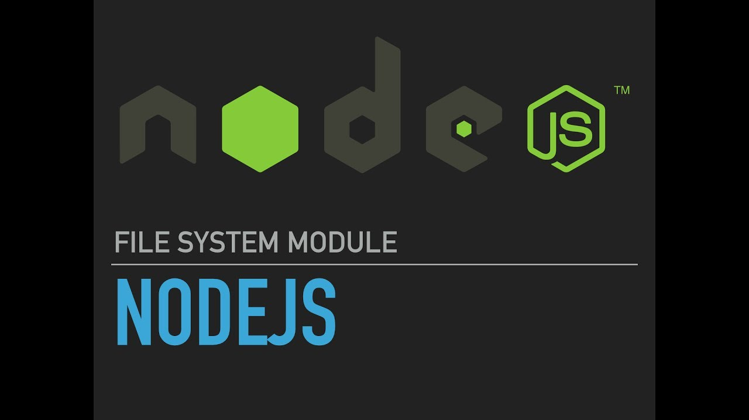
Opening Files in Node.js
Opening a file is the first step before reading or writing data to it.
The `fs.open()` method is used to open a file and obtain a file descriptor.
This file descriptor can then be used for further operations like reading or writing.
Notes:
Image source: https://www.youtube.com/watch?v=5jTXE9txzwQ

Slide 5
Syntax of `fs.open()`
const fs = require("fs");
// Asynchronous - Opening File
console.log("opening file!");
fs.open("input.txt", "r+", function (err, fd) {
if (err) {
return console.error(err);
}
console.log("File open successfully");
});
The basic syntax for `fs.open()` includes the file path, mode, and a callback function.
The mode specifies how the file will be opened, such as reading or writing.
The callback function handles any errors and provides the file descriptor upon success.
Notes:
Image source: https://eduinput.com/basic-syntax-of-c-plus-plus-program/

Slide 6
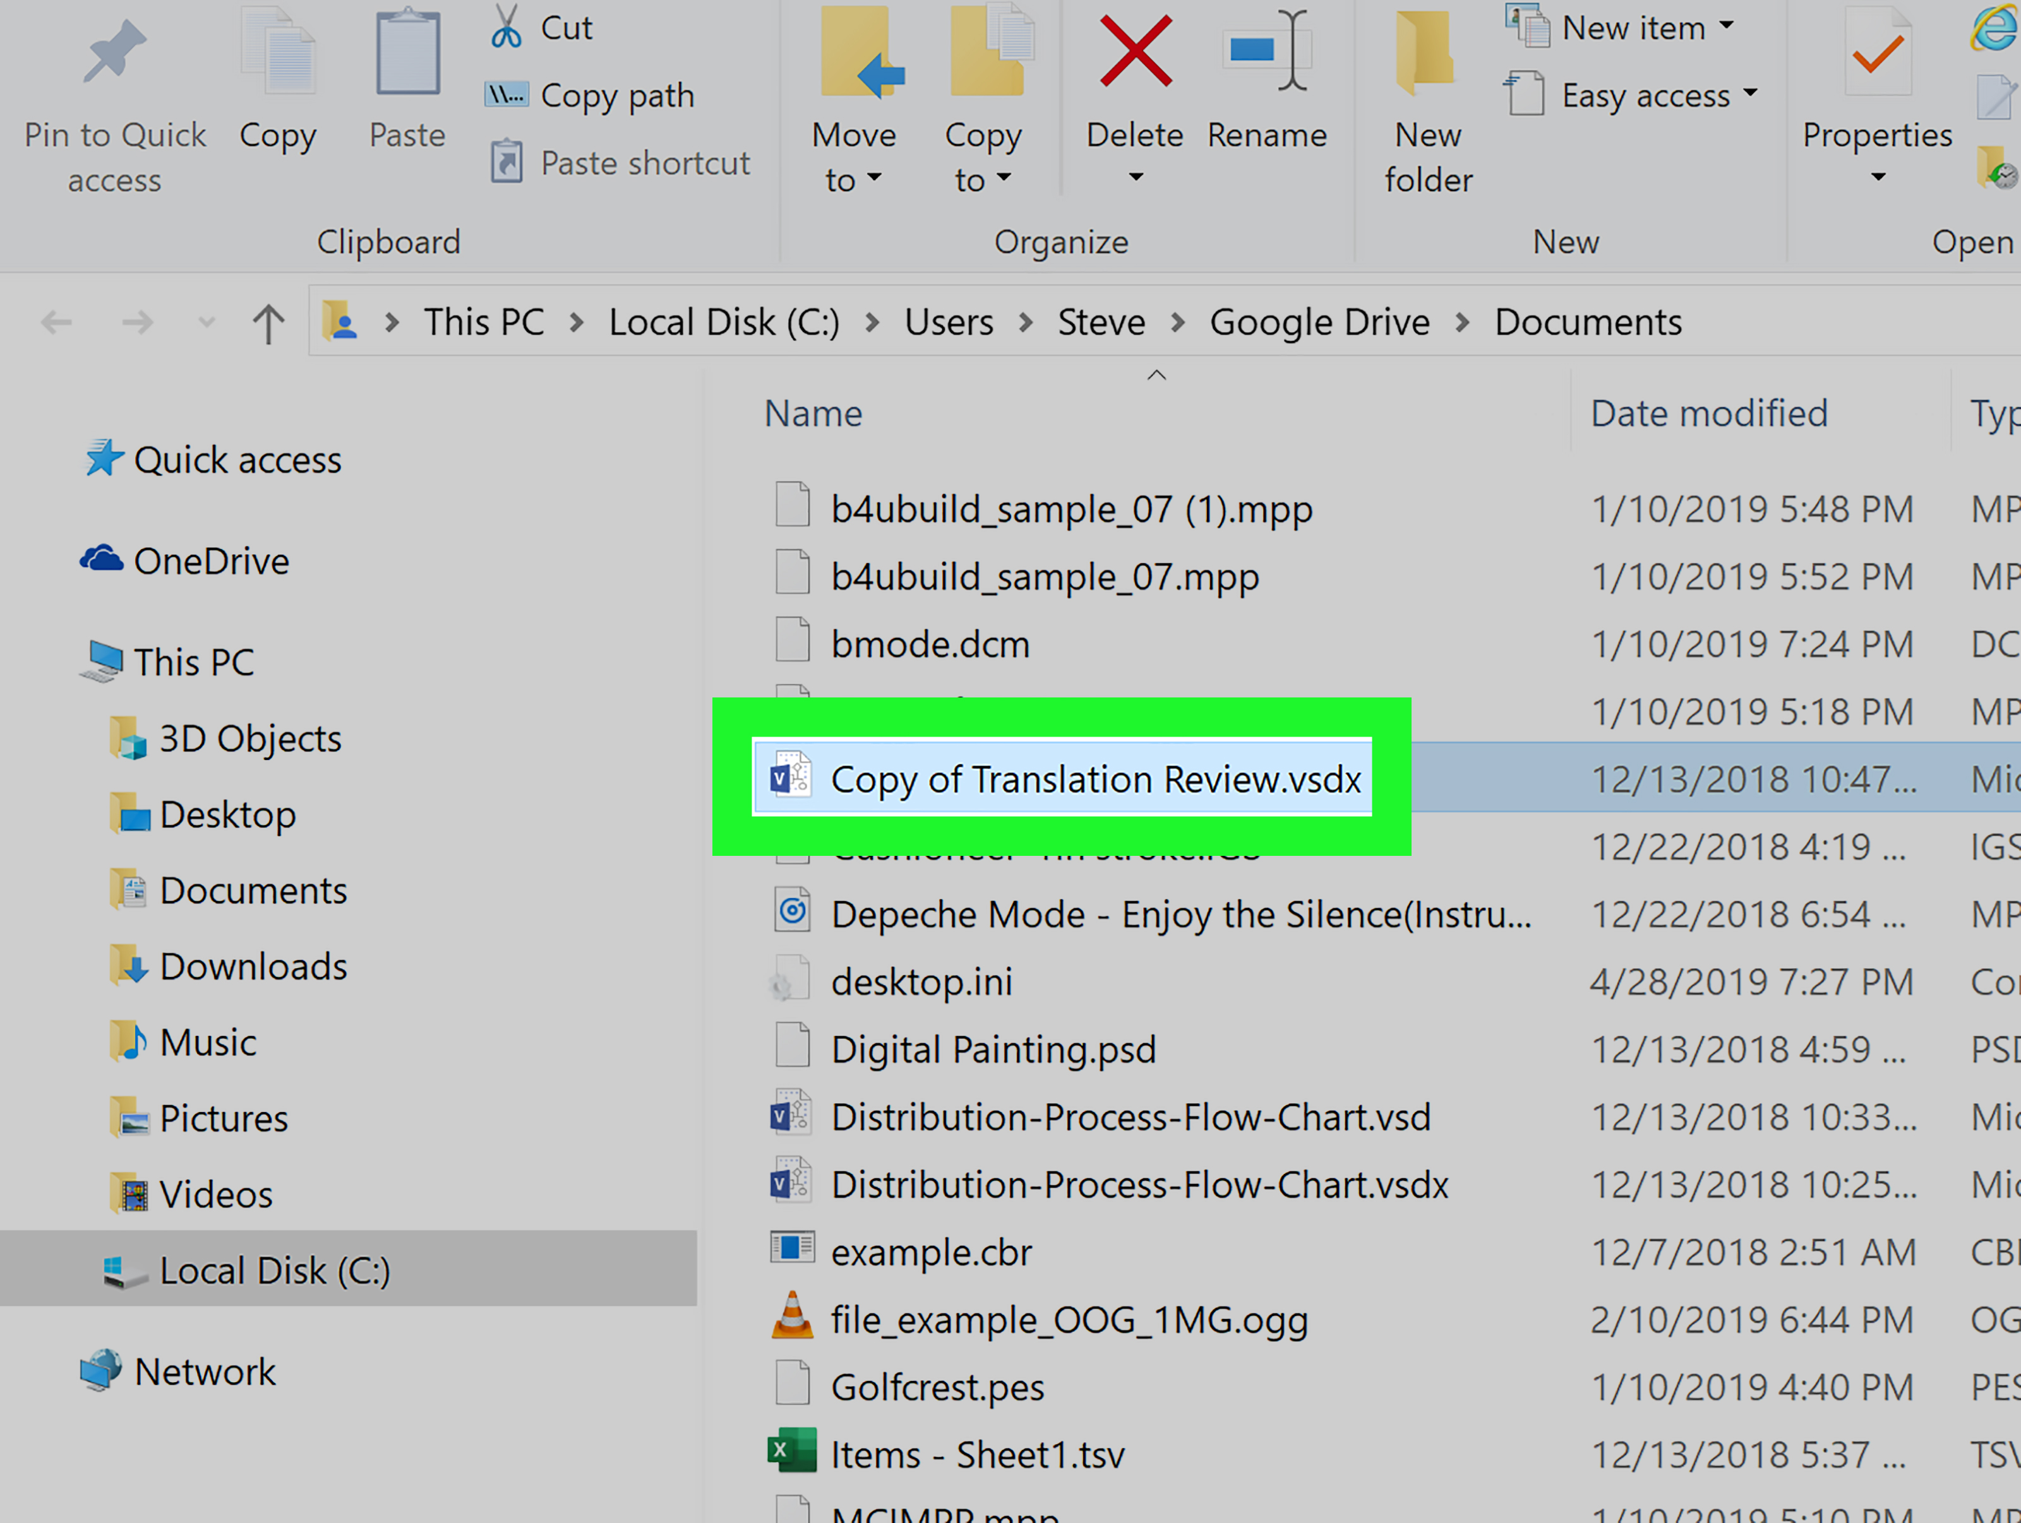
Example of Opening a File
To open a file, you can use the following code snippet: `fs.open('example.txt', 'r', (err, fd) => {...});`.
In this example, 'example.txt' is opened in read mode ('r').
If successful, the file descriptor `fd` will be available for further operations.
Notes:
Image source: https://dikipanel.weebly.com/blog/open-any-file

Slide 7
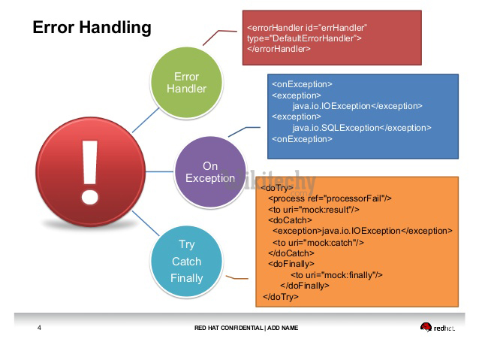
Handling Errors
Error handling is crucial when opening files to prevent crashes.
The first parameter of the callback in `fs.open()` is reserved for error messages.
Always check for errors before proceeding with further file operations to ensure data integrity.
Notes:
Image source: https://www.wikitechy.com/tutorials/laravel/laravel-error-handling

Slide 8
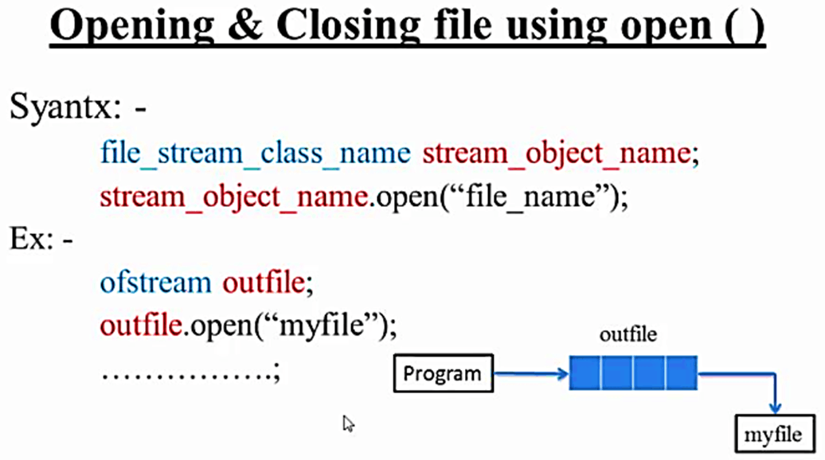
Closing the File
After opening a file, it is important to close it to free up system resources.
The `fs.close()` method is used to close a file descriptor once done.
Failing to close files can lead to memory leaks and file corruption in applications.
Notes:
Image source: http://fity.club/lists/o/opening-file/

Slide 9
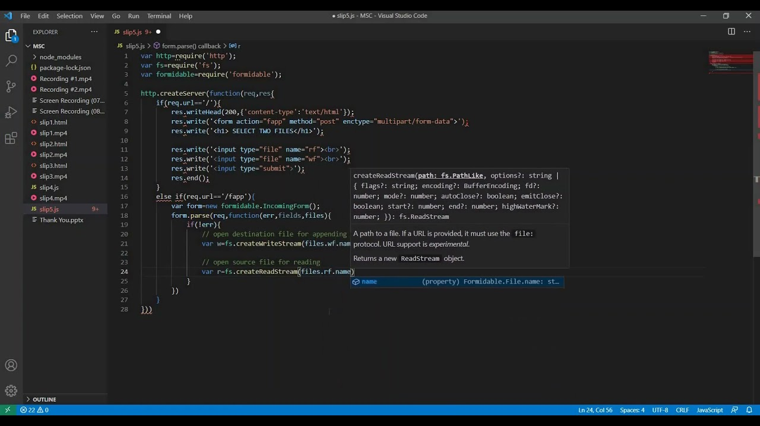
Summary and Best Practices
Accessing the file system in Node.js is straightforward with the `fs` module.
Always handle errors gracefully when opening files and ensure proper closure.
Following best practices ensures robust and efficient file management in your applications.
Notes:
Image source: https://www.youtube.com/watch?v=Fq92cYK6IP0

